Slide 1



DEPARTMENT OF COMPUTER SCIENCE & ENGINEERING
Domain Winter Winning Camp 2023
Subject Name: DBMS
Day: 5
Topics Covered: Cursor,Big data,Data Mining and Data Warehouse
DISCOVER . LEARN . EMPOWER

Slide 2
Prerequisite,Objective and Outcome
Prerequisite
Students should have basic knowledge of sql queries
Sql operations,joins
Sql queries and procedures
Objective
To retrieve data, one row at a time, from a result set
Student is able to manipulate the whole result set at once.

Slide 3
Outcome
At the end of this , the student will:
have a broad understanding of database concepts and database management system software
have a high-level understanding of major DBMS components and their function
be able to model an application’s data requirements using conceptual modeling tools like ER diagrams and design database schemas based on the conceptual model.
be able to write SQL commands to create tables and indexes, insert/update/delete data, and query data in a relational DBMS.
be able to program a data-intensive application using DBMS APIs.

Slide 4
Topic:
Implementing procedure using cursor
Introduction to Big data,Data mining and Data warehouse
What is a constraint?
Column Level Constraints
Table Level Constraints
Not Null Constraint
Unique Key Constraint
Default Constraint
Check Constraint

Slide 5
CURSORS
A cursor is a temporary work area created in the system memory when a SQL statement is executed.
A cursor contains information on a select statement and the rows of data accessed by it.
This temporary work area is used to store the data retrieved from the database, and perform intermediate operations before output is displayed to the client.
A cursor can hold more than one row, but can process only one row at a time.

Slide 6
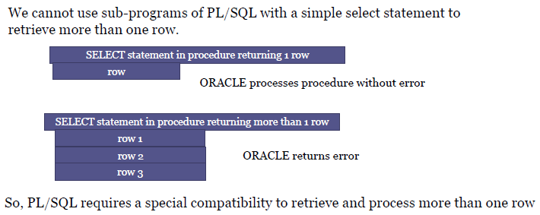
NEED FOR CURSORS?
Cursor is a mechanism that provides a way to select multiple rows of data from the database and then process each row individually inside a PL/SQL program.
The cursor first points at row1 and once it is processed it then
advances to row2 and so on.

Slide 7
Implicit Cursors
These are created by default when DML statements like, INSERT, UPDATE, and DELETE statements are executed.
The user is not aware of this happening & will not be able to control or process the information.
When an implicit cursor is working, DBMS performs the open, fetches and close automatically

Slide 8
The following table provides the description of the most used attributes −
Attribute Name | Description
%ISOPEN | Returns TRUE if cursor is open, FALSE if cursor is closed. SQL%ISOPEN always returns FALSE.
%FOUND | Returns TRUE if successful fetch has been executed, FALSE if no row was returned. SQL%FOUND is used to access it.
%NOTFOUND | Return TRUE if no row was returned, FALSE if successful fetch has been executed. SQL%NOTFOUND is used to access it.
%ROWCOUNT | Returns the number of rows affected by the query. SQL%ROWCOUNT is used to access it.

Slide 9
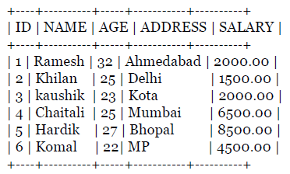
Example
Write a pl/sql program to update the salary of customers by Rs 500
Select * from customers;

Slide 10
Fetching the Cursor
Fetching the cursor involves accessing one row at a time.
Syntax:
FETCH cursor_name INTO record_name;
Example:
FETCH c_customers INTO c_id, c_name, c_addr;
Closing the Cursor
Closing the cursor means releasing the allocated memory.
Syntax:
CLOSE cursor_name;
Example:
CLOSE c_customers;

Slide 11
The following program will update the table and increase the salary of each customer by 500 and use the SQL%ROWCOUNT attribute to determine the number of rows affected −
DECLARE
total_rows number(2);
BEGIN
UPDATE customers
SET salary = salary + 500;
IF sql%notfound THEN
dbms_output.put_line('no customers selected');
ELSIF sql%found THEN
total_rows := sql%rowcount;
dbms_output.put_line( total_rows || ‘customers selected ');
END IF;
END;

Slide 12
Result:
6 customers selected
PL/SQL procedure successfully completed.
Select * from customers;
+‐‐‐‐+‐‐‐‐‐‐‐‐‐‐+‐‐‐‐‐+‐‐‐‐‐‐‐‐‐‐‐+‐‐‐‐‐‐‐‐‐‐+
| ID | NAME | AGE | ADDRESS | SALARY |
+‐‐‐‐+‐‐‐‐‐‐‐‐‐‐+‐‐‐‐‐+‐‐‐‐‐‐‐‐‐‐‐+‐‐‐‐‐‐‐‐‐‐+
| 1 | Ramesh | 32 | Ahmedabad | 2500.00 |
| 2 | Khilan | 25 | Delhi | 2000.00 |
| 3 | kaushik | 23 | Kota | 2500.00 |
| 4 | Chaitali | 25 | Mumbai | 7000.00 |
| 5 | Hardik | 27 | Bhopal | 9000.00 |
| 6 | Komal | 22 | MP | 5000.00 |
+‐‐‐‐+‐‐‐‐‐‐‐‐‐‐+‐‐‐‐‐+‐‐‐‐‐‐‐‐‐‐‐+‐‐‐‐‐‐‐‐‐‐+

Slide 13
Explicit cursors
Explicit cursors are programmer defined cursors for gaining more control over the context area.
An explicit cursor should be defined in the declaration section of the PL/SQL Block.
It is created on a SELECT Statement which returns more than one row.

Slide 14
The following table provides the description of the most used attributes −
Attribute Name | Description
%ISOPEN | Returns TRUE if cursor is open, FALSE if cursor is closed. CursorName%ISOPEN is used to access it.
%FOUND | Returns TRUE if successful fetch has been executed, FALSE if no row was returned. CursorName%FOUND is used to access it.
%NOTFOUND | Return TRUE if no row was returned, FALSE if successful fetch has been executed. CursorName%NOTFOUND is used to access it.
%ROWCOUNT | Returns the number of rows affected by the query. CursorName%ROWCOUNT is used to access it.

Slide 15
Explicit cursor involves four steps:
1.Declaring the cursor for initializing in the memory
2.Opening the cursor for allocating memory
3.Fetching the cursor for retrieving data
4.Closing the cursor to release allocated memory

Slide 16
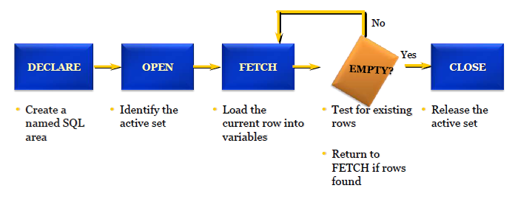
STEPS

Slide 17
Declaring the Cursor
Syntax:
CURSOR cursor_name IS select_statement;
For example:
CURSOR c_customers IS
SELECT id, name, address FROM customers;
Opening the Cursor
Syntax:
OPEN cursor_name;
Example:
OPEN c_customers;

Slide 18
EXAMPLE
DECLARE
c_id customers.id%type;
c_name customers.name%type;
c_addr customers.address%type;
CURSOR c_customers IS SELECT id, name, address FROM customers;
BEGIN
OPEN c_customers;
LOOP
FETCH c_customers into c_id, c_name, c_addr;
EXIT WHEN c_customers%notfound;
dbms_output.put_line(c_id || ' ' || c_name || ' ' || c_addr);
END LOOP;
CLOSE c_customers;
END;

Slide 19
RESULT:
1 Ramesh Ahmedabad
2 Khilan Delhi
3 kaushik Kota
4 Chaitali Mumbai
5 Hardik Bhopal
6 Komal MP
PL/SQL procedure successfully completed.

Slide 20
Advantages
Using Cursor we can perform row by row processing .
We can perform row wise validation or operations on each row.
Allow application to access and move around in a set of data rows, rather then merely retrieve a complete result set.
Disadvantages
Uses more resources
Speed and performance issues.
Increased network round trip.

Slide 21
SQL CONSTRAINTS
Constraints are the rules that we can apply on the type of data in a table.
These data constraints are connected to a cell by the DBA as a flag.
Whenever a user attempts to load a cell with data, DBA will check the data being loaded into the cell against the data constraint defined at the cell creation time.
If the data being loaded fails to satisfy any of the data constraint checks fired by the DBA, the DBA will not load the data into the cell, reject the entered record and will flash an error message.

Slide 22
CONSTRAINTS IMPLEMENTATION
Constraints can be divided into the following two types:
Column level constraints: These constraints are defined along with the column definition. These constraints can be applied to any one column at a time. If the constraints spans across multiple columns ,then the table level constraints are used.
Table level constraints: If the data constraint attached to a specific cell in a table references the content of another cell in the table then the table level constraint is used.

Slide 23
Constraints Types
The following constraints are commonly used in SQL:
NOT NULL - Ensures that a column cannot have a NULL value
UNIQUE - Ensures that all values in a column are different
PRIMARY KEY - A combination of a NOT NULL and UNIQUE. Uniquely identifies each row in a table
FOREIGN KEY - Uniquely identifies a row/record in another table
CHECK - Ensures that all values in a column satisfies a specific condition
DEFAULT - Sets a default value for a column when no value is specified

Slide 24
UNIQUE KEY CONSTRAINT
The purpose of a unique key is to ensure that information in the column for each record is unique.
Unique Key as a column constraint :
CREATE TABLE Persons (ID int UNIQUE, LastName varchar(255) NOT NULL,FirstName varchar(255),Age int);
Unique Key as a table constraint:
CREATE TABLE Persons (ID int ,LastName varchar(255) , FirstName varchar(255),Age int, UNIQUE (ID) );

Slide 25
DEFAULT CONSTRAINT
At the time of cell creation a ‘default value’ can be assigned to it.
When the user is loading a ‘record’ with values and leaves this cell empty,the DBA will automatically load this cell with the default value specified.
The data type of the default value should match the data type of the column.
CREATE TABLE people (ID int NOT NULL,LastName varchar(255) NOT NULL, FirstName varchar(255), Age int,
City varchar(255) DEFAULT 'Sandnes’);

Slide 26
SQL DEFAULT on ALTER TABLE
To create a DEFAULT constraint on the "City" column when the table is already created, use the following SQL:
MySQL:
ALTER TABLE People ALTER Age SET DEFAULT ‘10';
SQL Server:
ALTER TABLE People ADD CONSTRAINT df_Age DEFAULT ‘10' FOR Age;
MS Access:
ALTER TABLE People ALTER COLUMN Age SET DEFAULT ’10';
Oracle:
ALTER TABLE People MODIFY Age DEFAULT '10';

Slide 27
CHECK CONSTRAINT
It is used when we need to enforce integrity rules that can be evaluated based on a logical expression.
The CHECK constraint is used to limit the value range that can be placed in a column.
If you define a CHECK constraint on a single column it allows only certain values for this column.
If you define a CHECK constraint on a table it can limit the values in certain columns based on values in other columns in the row.

Slide 28
Example of check constraint
The following SQL creates a CHECK constraint on the "Age" column when the "Persons" table is created. The CHECK constraint ensures that the age of a person must be 18, or older:
CREATE TABLE Persons ( ID int NOT NULL,LastName varchar(255) NOT NULL,FirstName varchar(255),Age int,CHECK (Age>=18));
To allow naming of a CHECK constraint, and for defining a CHECK constraint on multiple columns, use the following SQL syntax:
CREATE TABLE Persons (ID int NOT NULL,LastName varchar(255) NOT NULL,FirstName varchar(255), Age int, City Varchar(255),CONSTRAINT CHK_Person CHECK (Age>=18 AND City='Sandnes‘));

Slide 29
NOT NULL CONSTRAINT:
By default, a column can hold NULL values.
The NOT NULL constraint enforces a column to NOT accept NULL values.
Not Null maintains some proper values other than NULL.
A NULL is not the same as no data, rather, it represents unknown data. Null represents a record where data may be missing data or data for that record may be optional
A not-null constraint cannot be applied at table level

Slide 30
Example
The following SQL statement ensures that the "ID", "LastName", and "FirstName" columns will NOT accept NULL values when the "Persons" table is created:
CREATE TABLE Persons ( ID int NOT NULL, LastName varchar(255) NOT NULL, FirstName varchar(255) NOT NULL, Age int );

Slide 31
Primary Key
PRIMARY KEY is a column or group of columns in a table that uniquely identify every row in that table. The Primary Key can't be a duplicate meaning the same value can't appear more than once in the table. A table cannot have more than one primary key.
Syntax
CREATE TABLE table_name
(
column1 datatype [ NULL | NOT NULL ] [ PRIMARY KEY ],
column2 datatype [ NULL | NOT NULL ]
, ... );

Slide 32
Rules For Defining Primary Key
Two rows can't have the same primary key value
It must for every row to have a primary key value.
The primary key field cannot be null.
The value in a primary key column can never be modified or updated if any foreign key refers to that primary key.
For example:
CREATE TABLE employees
( employee_id INT PRIMARY KEY,
last_name VARCHAR(50) NOT NULL,
first_name VARCHAR(50) NOT NULL,
salary MONEY
);

Slide 33
Primary Key Constraints
Primary Key constraint is a rule that the values in one column or a combination of columns must uniquely identify each row in a table
No primary key value can appear in more than one row in the table
To satisfy a primary key constraint, both of the following conditions must be true:
No column that is part of the primary key can contain a null
A table can have only one primary key

Slide 34
Primary Key Constraints
Primary Key constraint is a rule that the values in one column or a combination of columns must uniquely identify each row in a table
No primary key value can appear in more than one row in the table
To satisfy a primary key constraint, both of the following conditions must be true:
No column that is part of the primary key can contain a null
A table can have only one primary key

Slide 35
Foreign Key
FOREIGN KEY is a column that creates a relationship between two tables. The purpose of Foreign keys is to maintain data integrity and allow navigation between two different instances of an entity. It acts as a cross-reference between two tables as it references the primary key of another table.
Syntax
CREATE TABLE Orders
( OrderID int NOT NULL, OrderNumber int NOT NULL, PersonID int, PRIMARY KEY (OrderID), FOREIGN KEY (PersonID) REFERENCES Persons(PersonID) );

Slide 36
Foreign Key (Referential Integrity) Constraints
Foreign Key constraints are also called “referential integrity” constraints.
Foreign Key constraints designate a column or a combination of columns as a foreign key.
A foreign key links back to the primary key (or a unique key) in another table, and this link is the basis of the relationship between tables.

Slide 37
Foreign Key Constraint Syntax
The syntax for defining a foreign key constraint requires a reference to the table and column in the parent table.
A foreign key constraint in a CREATE TABLE statement can be defined as follows.
Column-level syntax example:
CREATE TABLE copy_employees
(employee_id NUMBER(6,0) CONSTRAINT copy_emp_pk PRIMARY KEY,
First_name VARCHAR2(20),
Last_name VARCHAR2(25)),
Department_id NUMBER(4,0) CONSTRAINT c_emps_dept_id_fk
REFERENCES departments (department_id),
email VARCHAR2(25));

Slide 38
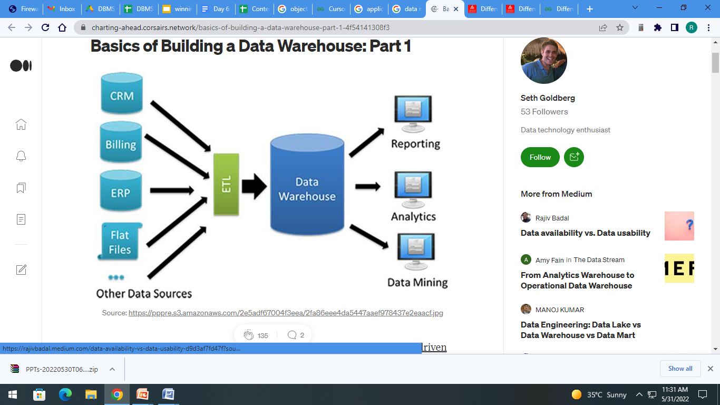
Dataware house VS DataMining

Slide 39
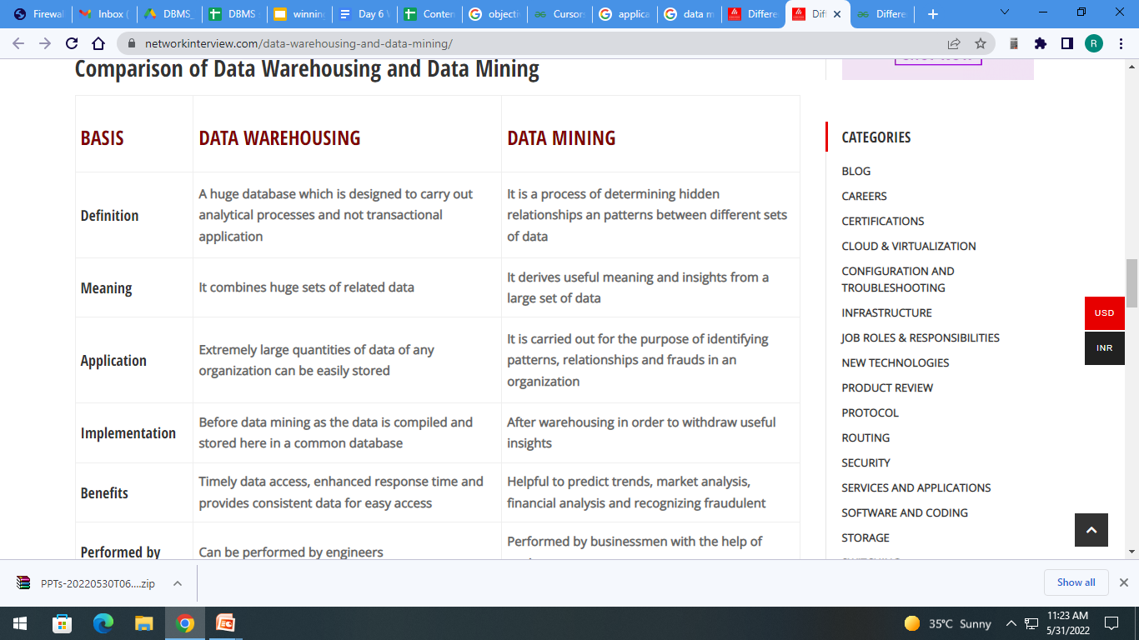
Data warehouse Vs Data Mining

Slide 40
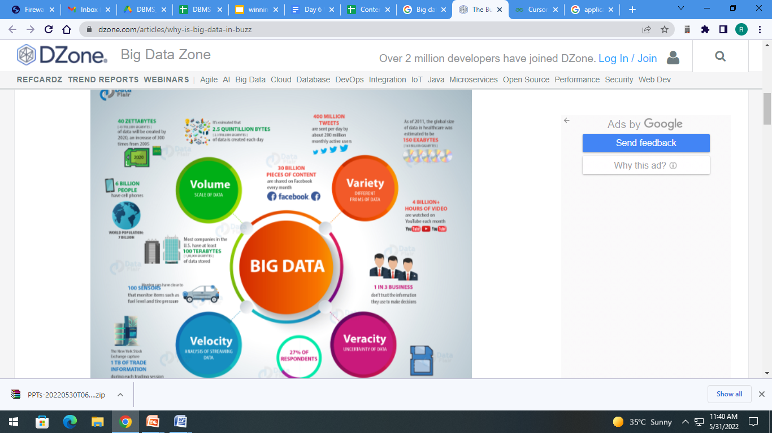
Big Data (4vs of Bigdata)

Slide 41
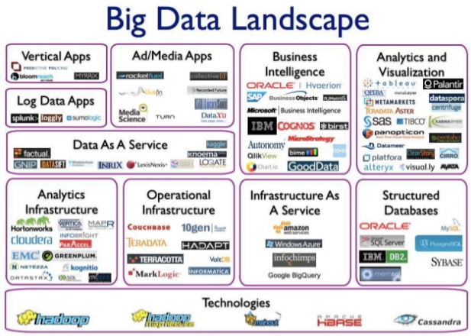
TECHNOLOGIES FOR BIG DATA

Slide 42
Interview Questions
What are the different types of constraints in SQL?
Can foreign key be null?
What is CHECK Constraint?
How to drop a FOREIGN KEY constraint?
What is the purpose of normalization in DBMS?
What is trivial functional dependency in dbms
What is transitive functional dependency in dbms
What is 3NF in the DBMS?
Which normal form is based on the concept of ‘full functional dependency?
What is the difference between BCNF and 3NF?
What is the purpose of normalization in DBMS?

Slide 43
PRACTICE QUESTIONS
Write a program in PL/SQL to print the prime numbers between 1 to 50
PL/SQL program to check whether a number is positive, negative or zero.
Creating a PL/SQL program to implement cursors
Write a program in PL/SQL to print 1st n numbers with a difference of 3 and starting from 1.

Slide 44
References
SQL, PL/SQL by Ivan Bayross.
https://www.slideshare.net/ravi_LCET/data-warehousedata-mining-big-data
https://dwbi1.wordpress.com/2012/07/14/what-is-big-data-data-warehouse-data-mining/
https://www.sciencedirect.com/book/9780123814791/data-mining-concepts-and-techniques
https://nptel.ac.in/courses/106/104/106104189/
https://nptel.ac.in/courses/110/107/110107095/
http://charting-ahead.corsairs.network/basics-of-building-a-data-warehouse-part-1-4f54141308f3
https://networkinterview.com/data-warehousing-and-data-mining
https://dzone.com/articles/why-is-big-data-in-buzz

Slide 45
THANK YOU

